Slide 1
CATCH:
Coordinated Approach to Child Health

Slide 2
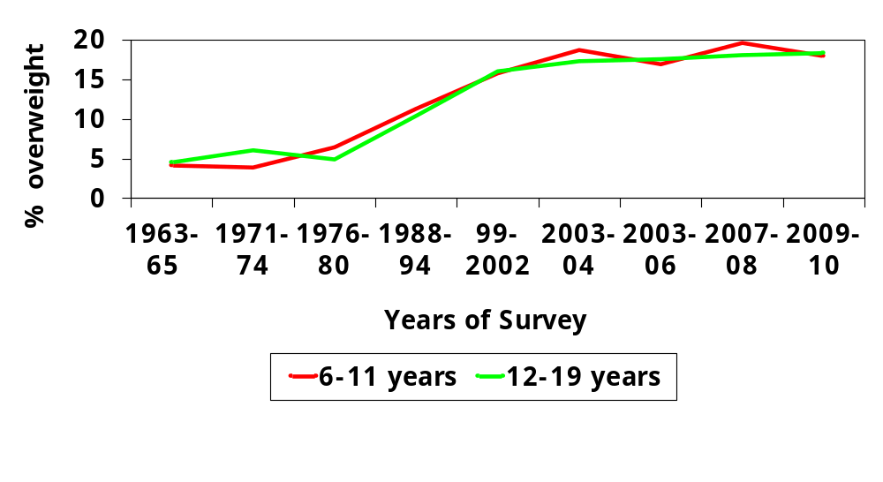
Why CATCH?
Obese Children and Adolescents: NHANES
Equal or greater than 95% age/sex CDC Growth Charts
Sources: Medline, 2006;
Ogden et al. JAMA;195:1549-55; Hedley et al. JAMA;291:2847-2850;
Ogden et al., 2008; Ogden et al., 2010; Ogden et al., 2012
Notes:
Script: Okay, keeping our basic assumption in mind, take a look at this graph. This shows the obesity statistics for kids and teenagers over the last 40+ years. Notice that the rates were right around 5% back in the 60’s and 70’s, and that’s the goal – we don’t want any more than 5% of the youth population to be in that obese category. However, you see in the 80’s those rates start going upwards. It leveled off just a bit in the early 2000’s, but even now it’s still slightly increasing. The latest numbers we have are from 2006 and the nationwide average is about 18-19% of our kids are in that obese range.
So, thinking about that assumption, what are some things that have happened in our environment to contribute to this increase? <Get input from participants. Responses may include: fast food, computers/video games, single parent homes, less physical activity, safety concerns, processed foods, etc. Acknowledge the important factors that participants have mentioned.>
You all hit the nail on the head, all these things you’ve mentioned have contributed to this obesity problem. You mentioned both sides of the key equation: diet – energy in, and physical activity – energy out. Now let’s take a look at some specifics about both sides of that equation.

Slide 3
Obesity Trends* Among U.S. Adults
BRFSS, 1990, 1999, 2008
(*BMI ≥30, or about 30 lbs. overweight for 5’4” person)
1990
1999
2008
No Data <10% 10%–14% 15%–19% 20%–24% 25%–29% ≥30%
Source: CDC Behavioral Risk Factor Surveillance System
Notes:
Script: So, looking back over the years…back in the early 1990’s, all the states are in the blue colors. By the end of the 90’s, about half the states are above the 20% level. And, now in the late 2000’s, almost all the states are at 20% or greater in terms of obesity rates.
Now then, this all happened over the last 20+ years. So, as we think about changing this trend, it’s important that we realize that it’s not going to change overnight. It’s going to take time to reverse this trend. And that brings us to our second assumption…

Slide 4

Why CATCH? Because it works!
CATCH components:
demonstrated an increase in vigorous physical activity levels and activity time after school and on the weekend;
have shown a decrease in TV watching and sedentary activities;
have shown improvements in standardized test scores;
demonstrated effects in increasing bone density (e.g., stiffness index).
Notes:
The CATCH components have shown positive results in health behaviors, including: highlight information in the bullets.

Slide 5
What is CATCH &
Coordinated School Health?
Coordinated School Health
A process which brings a school community together to teach children to be healthy for a lifetime.
CATCH
A fun and exciting program that promotes physical activity and healthy food choices.
A coordinated and doable program that will be implemented campus-wide!
Notes:
Because of the current obesity crisis, TEA has mandated that all elementary and middle schools select and implement a coordinated school health program. You’ve probably heard the term “Coordinated School Health,” but what does that actually mean? It is a process that brings folks in a school together to coordinate their efforts to teach kids to be healthy for a lifetime. CATCH (Coordinated Approach to Child Health) is an example of a Coordinated School Health Program. It helps create an atmosphere where students see, hear, plan and act with regard to their health habits. Read slide for CATCH definition.

Slide 6
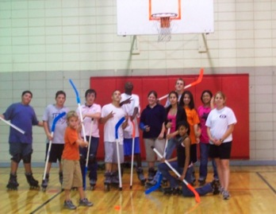
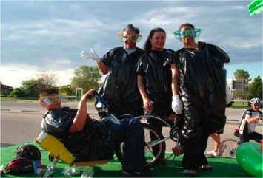
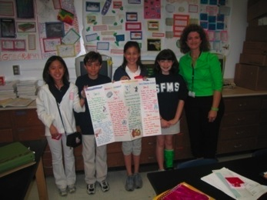
CATCH Coordinated Framework
CATCH Team & Coordination Guide
Nutrition Services
Physical Education
Classroom Education
Family Education
Activity Breaks
Before & After School
Environments directly shape behavior!

Slide 7
District Goal
To have schools where everyone is working together and speaking a common language that creates and maintains a healthy school environment.
Notes:
Script: Again, the overall goal here is to create a healthy learning environment for everyone by working together and speaking a common language about health and wellness on a campus.

Slide 8


The “Language of CATCH”
CATCH blends coordination throughout multiple components by using consistent language.
  GO, SLOW, & WHOA Foods
  CATCH MVP

Slide 9

GO – SLOW – WHOA
GO foods are lower in fat, and/or added sugar, and/or they are less processed relative to foods in the same food group and are commonly described as ‘whole foods’.
SLOW foods are higher in fat, and/or added sugar, and may be more processed than GO foods.
WHOA foods are highest in fat, added sugar, and/or are the most

Slide 10
CATCH MVP School
Aims to achieve healthy behaviors and positive outcomes in the following areas:
  Move and stay active
  Value healthy eating
  Practice healthy habits

Slide 11
Activity Break
Zero In
(a math break)
Notes:
Equipment: Card stock/piece of paper with a number or equation
Organization:
Students stand at their desks.
The teacher should prepare several cards/pieces of paper with a number or equation (e.g., 283; 50 x 7).
Description:
The object of this activity is for 1 student to correctly guess a number with the aid of his or her classmates.
The student does this by receiving movement clues from the class until she or he has “zeroed in” on the correct number.
Select 1 student to come to the front and stand facing the class.
The teacher stands behind the student and holds up the equation/number card for the rest of the class to see (without the student in the front of the class seeing the card).
Direct the student to call out a number between 1 and 500 (or an alternative range based on the identified number or equation answer).
The class helps the student “zero in” to guess the number on the card by squatting if the student needs to guess lower or jumping up and down if the student needs to guess higher.
Based on these responses from the class, the student continues to call out numbers until he or she correctly guesses the number.

Slide 12

Who’s involved?
EVERYONE
  Everyone has a role and resources to use in implementing CATCH on the campus.
The CATCH Team
  The CATCH Team mobilizes the school community and guides the process.
Notes:
Script: So, who’s involved? EVERYONE! Each person on a campus has a role as well as resources to use in order to be involved in this coordinated effort. Each person has one piece to the puzzle and together those pieces coordinate and fit together to create that big picture of a healthy school environment.

Slide 13
Who’s involved cont.?
The CATCH Champion:
  Leader of the CATCH Team
  Keeper of the CATCH materials/resources
  Charged with keeping the CATCH ball rolling

Slide 14











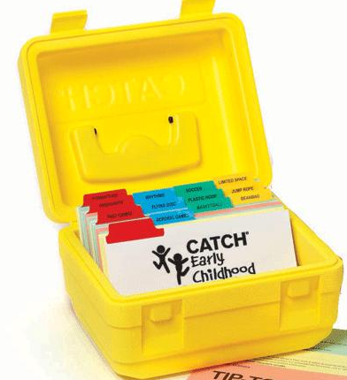

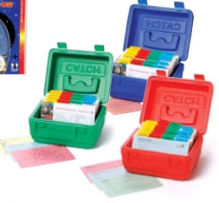







What are the resources?
The CATCH Program Materials
Notes:
Procedure:
1) If available, direct participants’ attention to the display of CATCH materials.
Script: What are you going to use? What will you have available to help support a healthy environment? Everything you see here are the resources available with CATCH. Materials for just about everyone on a campus to do their part and be involved in this effort, because remember it’s not about adding more to your workload. It’s about everyone doing their little part and together it making a big difference.

Slide 15
Child Nutrition Materials
Eat Smart Guidebook & Coordination Folder
Notes:
Script: The Child Nutrition materials include the Eat Smart Guidebook and Coordination Folder. Each of these materials offer concrete ways for child nutrition to support and promote healthy eating, and really coordinate efforts with the rest of the school.

Slide 16



K-8 Classroom Materials
Notes:
Script: The K-8 Classroom materials include the Classroom Curriculum and Coordination Folder.

Slide 17
Specialized & Support Staff Materials
Coordination Folder & Classroom Supplements
Notes:
Script: The Specialized and Support Staff Materials include the P.A.S.T and F.A.C.T.S curriculum supplements (which are often used by nurses or counselors) as well as a Coordination Folder.

Slide 18
Family Materials
Coordination Folder & Home Team Materials
Notes:
Script: The Family Materials include the Classroom Curriculum and Coordination Folder. Within the classroom curriculum there are interactive assignments and activity packets designed for families to participate in and learn about together as a team.

Slide 19

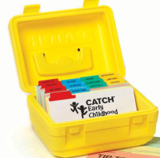
CATCH PE Materials
Coordination Folder & PE Activity Boxes and Guidebook
Notes:
Script: The PE Materials include the K-2 & 3-5 Activity Boxes, PE Guidebook and Coordination Folder.

Slide 20







The CATCH Resources
To review:
  All CATCH Program Materials are designed to promote physical activity and healthy eating.
  Everyone has materials and resources to get involved!
Notes:
Script: As a review, ALL CATCH program materials are designed to help meet your coordinated school health initiative. The “language of CATCH” is blended throughout the CATCH materials and each area has their own resources to promote and support eating healthy and being physically active.

Slide 21


How do the schools coordinate their efforts?
The CATCH Coordination Toolkit
The Coordination Toolkit is a “roadmap” to help organize the CATCH Team and campus efforts.
There are 6 Six-Week Themes in the Coordination Toolkit that focus implementation on a common
school-wide initiative.
Each 6 weeks/theme, everyone has doable tasks/initiatives to implement campus-wide.

Slide 22
CATCH Coordination Toolkit
CATCH Team Coordination Guide
  Guides the CATCH Team in implementing CATCH campus-wide.
CATCH Coordination Folders
  Provide tasks and resources for the 6 component areas: Principals & Administration, Classroom Teachers, Child Nutrition Services, PE, Parent Leaders and Specialized and Support Staff.

Slide 23
District Goal: To have all schools…
Speaking a Coordinated Language
    GO, SLOW, WHOA
    CATCH MVP
Utilizing the CATCH Resources
  CATCH Component Materials
    Eat Smart Guidebook, PE Activity Box & Classroom Lessons
  CATCH Coordination Toolkit
    Team Coordination Guide
    Component Specific Coordination Folders

Slide 24

Let’s Make the Healthy Choice Easy!
Support the Coordinated School Health/CATCH Team
Model healthy behaviors
It takes EVERYONE working together!
Notes:
Specific examples:
Support the CSH Team:
Attend CATCH meetings
Offer to help with CSH events
Model healthy behaviors:
Drink water in the hallways
Eat in the cafeteria
Implement your component specific tasks:
Incorporate activity breaks into your lesson plans
Declare your classroom a healthy zone

